Slide 1
The Enlisted Association Chapter 39
15821 E Centretech Cir
Aurora Co 80011
15821 E Centretech Cir
Aurora CO 80011
303-340-3939
October, November, December 2023

Slide 2
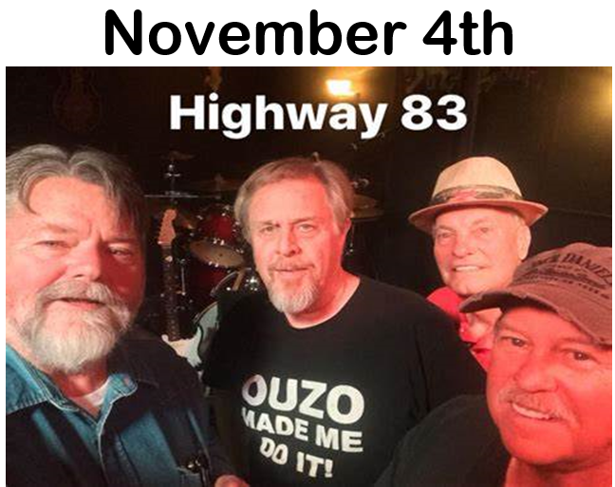
A WORD FROM THE PRESIDENT
THINGS TO DO AT CHAPTER 39
SEE CALENDARS FOR DETAILS
As some of you may know, there was a unanimous vote at our September BOD meeting as well as our September General Membership meeting that we should not move to a new location but should remain at our present location. I want to thank all who attended our meeting and participated in the voting. It is when we are united that we are truly TREA 39! It is my hope that our members will support this choice to stay at our present location by attending our various dinners, entertainments, and by enjoying the Club during the week. Your support is important to the mission of TREA 39 as we support our Service Members, their families, and each other!
Without your support, we cannot accomplish our goals!
United We Stand
Mary Clarvoe, President
TREA Chapter 39
A WORD FROM THE AUXILIARY
Here the year is almost over. We had it good this year. In September our fall wine tasting had a good turnout with everyone enjoying the food, fun, and of course, the wine. September was also a sad time as we lost one of our members, Shirley Lovato. She will be truly missed. We had our conference in Vegas this year and we learned a lot and enjoyed the opportunity to meet other members. I want to thank everyone who comes to our dinners and buys the baked goods. Our meeting are the 3rd Sunday of the month at 1pm and I hope to see you there.
United We Stand
Helen Suggs, President
TREA Chapter 39 Auxiliary
Bison Burger Dinner July 16th
October 1st 5:30-7pm
MANAGER’S MINUTE
Brrrrr, summer may be over, but the fun is still here. The coffee is always hot, the beer is always cold, and your bartenders are always ready to serve! The conversations about the future of the Chapter have brought some new, and some remembered faces in, but we’d love to see more of you. Do you have a great idea for an event? Reach out to a member of the A&E Committee and let them know what it is! We’ll need everyone’s support to make this the best season yet.
As always, this is your Club, come in and enjoy it!
Charlie Keith
Club Manager
Queen of Hearts drawing every Saturday at 7:00pm.

Slide 3
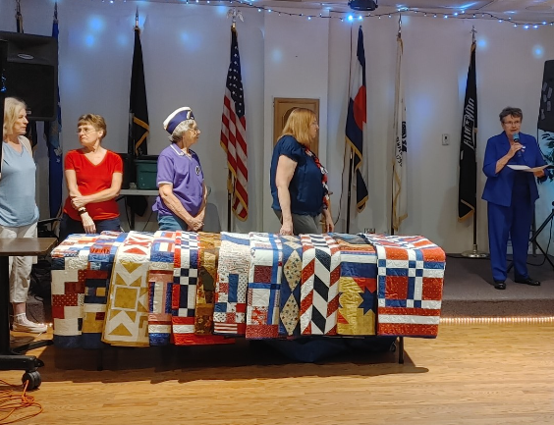
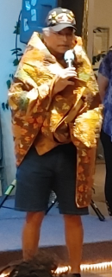
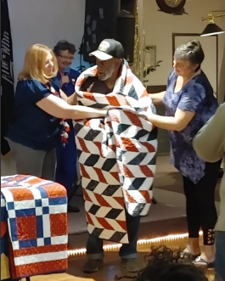
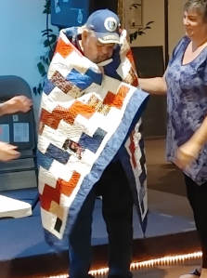
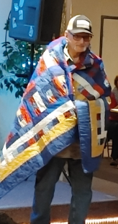
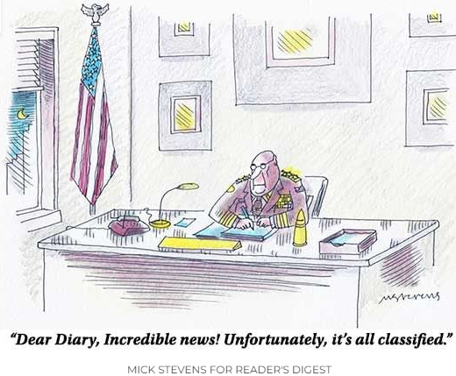
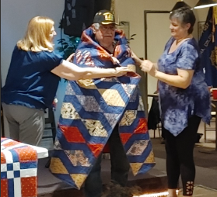
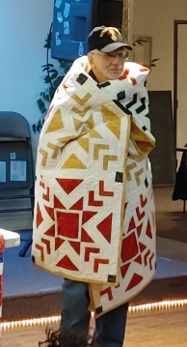
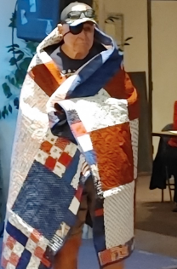
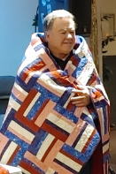
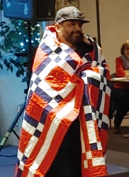
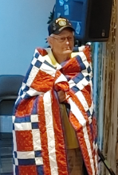
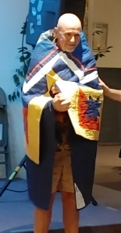
CLUB WISH LIST
Want to help out your club but are limited for time? Here are a few things that we consistently need and would appreciate having donated:
Bar snacks 13 Gallon trash bags
Paper dinner/cake plates 50 Gallon trash bags
Dinner napkins Paper salad bowls
Plastic silverware Red solo cups
Quilts of Valor September Presentations
"Sometimes you lie in bed at night, and you don't have a single thing to worry about. That always worries me!" —Charlie Brown
Nominate a Service Member or Veteran to receive a quilt: https://www.qovf.org/nominations-awards/

Slide 4
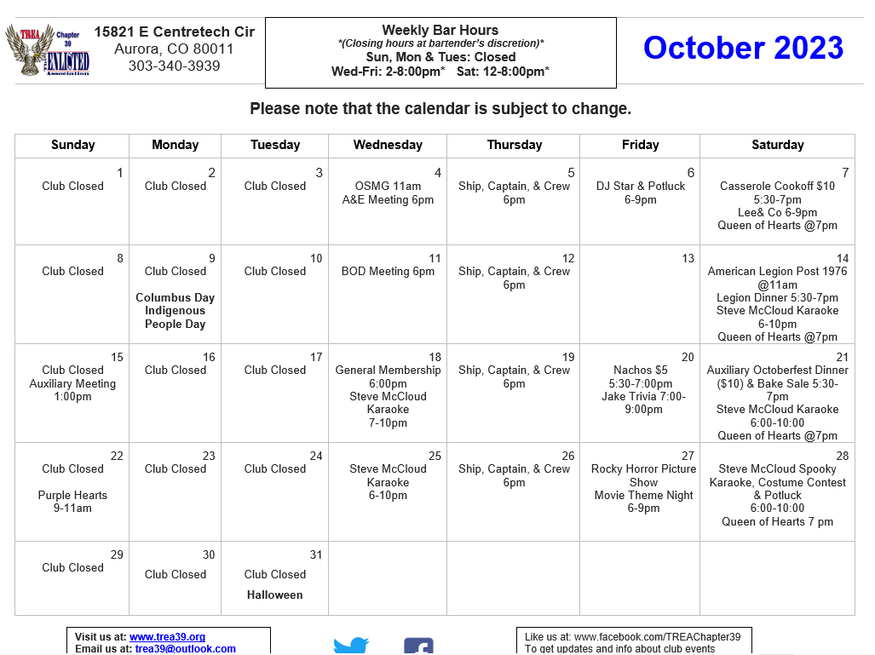

Slide 5
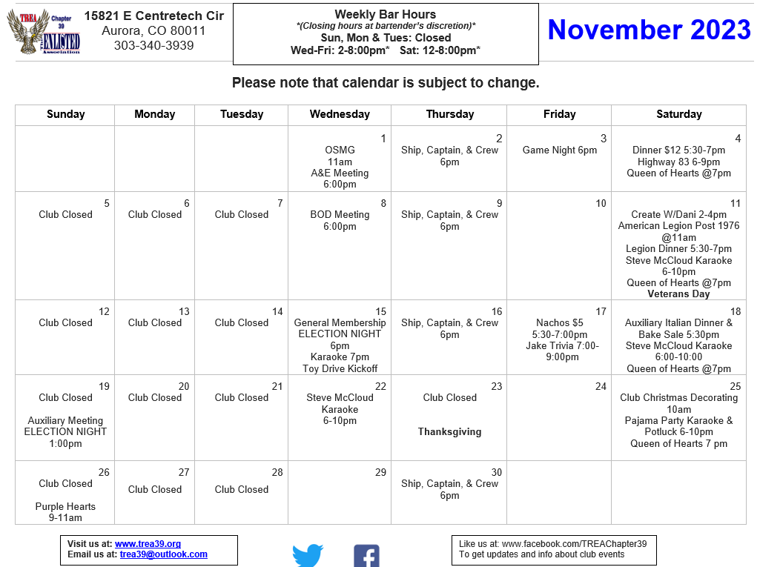

Slide 6
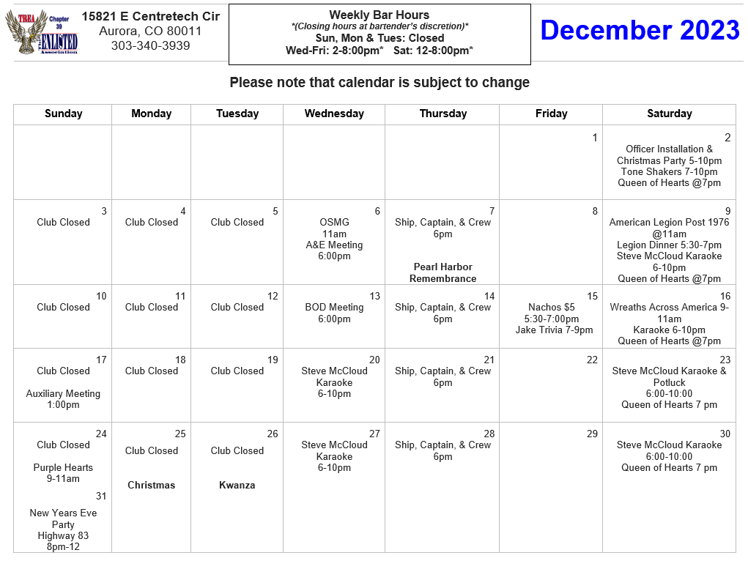
Q: How do mountains stay warm in the winter? A: They put on their snowcaps!

